Slide 1

Python implementation of Gaussian Plume model
Dr. R. Bloem

Slide 2
Today
Goal of the meeting is to see what has to be done to get this to work for the measurements later this month
Explain the basics of the model
Hopefully not too much implementation details
What do you need?
If there is time: go through the model
Another time
Answer questions I mailed yesterday
Actually work with the model

Slide 3
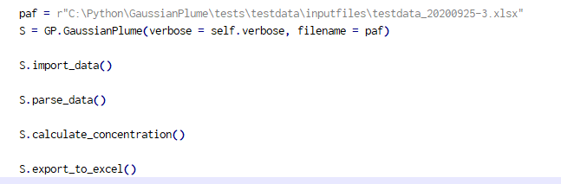
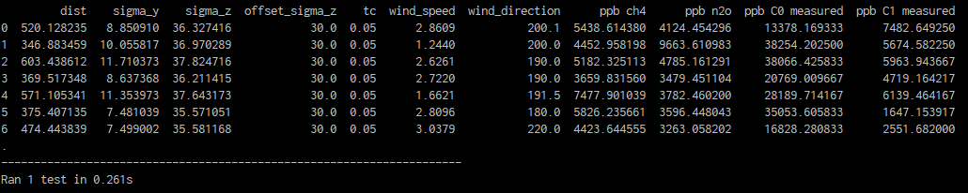
Four step process
Import data
From different files
Parse data
Put everything in the right place
Calculation
Export results
In between values can be changed as required

Slide 4
Vans, farms, ships…
Numerical Python (NUMPY)
Numpy does matrix calculations, a bit comparable to Matlab
You can do calculations of
> Two numbers
> A number and an array
> Two arrays of the same length
For example: location of the source times the location of the measurement
Take-away:
Data is either a number, or is an array with length of the number of data points
Source = 2
Measurement = 10
Source * Measurement = 20
Source = numpy.array([1,2,3])
Measurement = 10
Source * Measurement = [10,20,30]
Source = 2
Measurement = numpy.array([10,100,1000])
Source * Measurement = [20,200,2000]
Source = numpy.array([1,2,3])
Measurement = numpy.array([10,100,1000])
Source * Measurement = [10,200,3000]

Slide 5
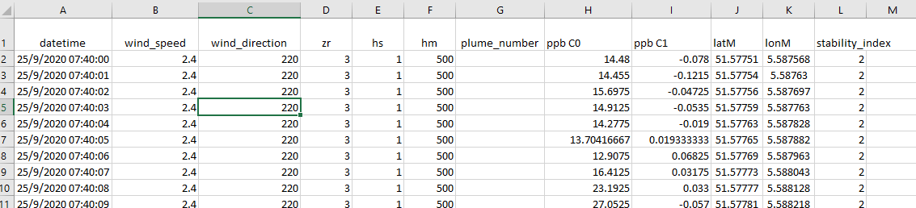
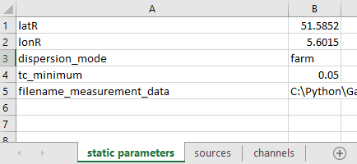
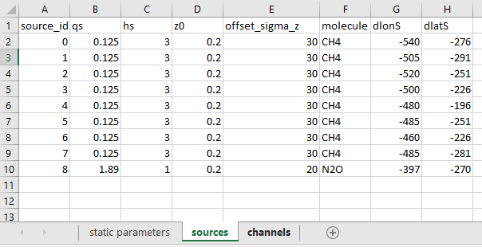
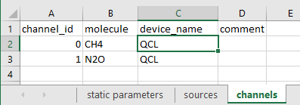
Data files
Measurement data
Data points
Either in csv or Excel
Dynamic parameters
See later slide
Static parameters
Things that don’t change during the measurement
Sources
An overview of the sources (doesn’t change during measurement)
Channels
A measurement channel
A device can have multiple channels
Different channels can measure the same molecule
Array
Number
2 CH4 MIRA

Slide 6
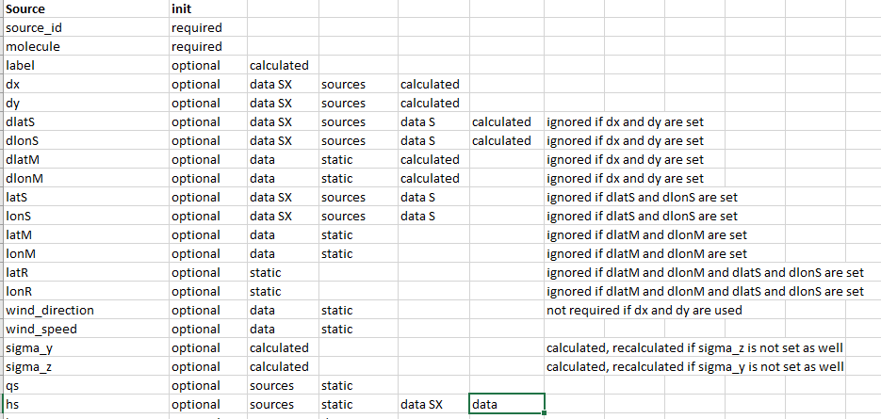
Which parameters go where?
For every parameter, the program will look in the measurement data and/or the source table and/or static parameters, …
There is an Excel with an overview
More is possible
Parameters can be in different places
The program keeps track of what was used (to a certain extent), but…
Highly advisable: give every parameter once

Slide 7


How does it work?
for source in sources_list:
if source.hs == None:
if “hs” in Sources:
set source.hs to this value
else if “hs” in Static:
set source.hs to this value
else if “hs S<source.source_id>” in Data:
set source.hs to this value
else if “hs” in Data:
set source.hs to this value
else:
error
What does it mean?
Initialization: set manually (for debugging)
Sources: 1 value for all datapoints, per source
Static: 1 value for all datapoints, for all sources
Data SX: 1 value per datapoint, per source
Data: 1 value per datapoint, for all sources
Calculated
Error (unless it can be calculated)
I’m working on making it possible to mix-and-match where the values are found, but this needs some testing
For some sources hs in is Sources, for other sources in Data
What does it mean?
Sources: 1 value for all datapoints, per source
Static: 1 value for all datapoints, for all sources
Data SX: 1 value per datapoint, per source
Data: 1 value per datapoint, for all sources
Calculated
It should be possible to mix-and-match where the values are found, but this needs some testing

Slide 8
Example: farms
Straightforward

Slide 9
Example: ships
Measurement position: in static parameters
Source:
You can reuse a source for different ships (assuming there is no overlap)
You can make a different source for each ship
Source:
Position: in measurement data (as latS, lonS, or as latSX, lonSX)
Stack height: in dynamic parameters?

Slide 10
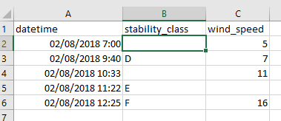
Dynamic parameters
(to be finalized)
Parameters that change irregularly
For example: stack height of a ship
Stability_class and wind_speed were used for testing but are bad examples
Is added to measurement data
Values are repeated until the next change, no interpolation
If a value is missing, the previous value is used
If there is no previous value, it is Not-A-Number (for example between 7 and 9:40 for stability_class)
Can be used for weather data, but it may be better to do make something that interpolates data
Interpreted as
NaN
D
11

Slide 11
Details 1
Calculation is done for all data, after which the data can be extracted
23400 data points processed in 0.2 second
The concentration is NaN when:
Values are missing
> Exception: plume_number, missing values are set to 0
> If plume_number is missing, it is generated and all are set to 1
When dx < 0
Is a warning needed if the results contain a NaN?
NaN is now treated as zero.

Slide 12
Details 2
There is a warning when distances are more than 100 km:
Source and measurement
Source and reference
Measurement and reference
Goal: avoid switching lat/lon
Is 100 km reasonable?
All measurements are done at the same location
This would be hard to change
Data smoothing is not implemented (yet?)
Time shift due to measurement delay is not implemented (yet?)
1 location emits two compounds → define two different sources

Slide 13
Output
What needs to be exported?
Results only
Results + some key parameters
Results + all details
In what format?
Excel?
With what filenames?
Overwrite previous output?

Slide 14

Thank you for
Your time

Slide 15
Basis of the implementation
Model is build in Python, using the Numpy and Pandas modules
Numpy does matrix calculations, a bit comparable to Matlab
You can do calculations of
> Two numbers
> A number and an array
> Two arrays of the same length
For example: location of the source times the location of the measurement
Now we only need to get the right data in the right place
Pandas is bit comparable to Origin
Mostly used for importing/exporting
Source = 2
Measurement = 10
Source * Measurement = 20
Source = numpy.array([1,2,3])
Measurement = 10
Source * Measurement = [10,20,30]
Source = 2
Measurement = numpy.array([10,100,1000])
Source * Measurement = [20,200,2000]
Source = numpy.array([1,2,3])
Measurement = numpy.array([10,100,1000])
Source * Measurement = [10,200,3000]

Slide 16
Which parameters go where?
For every parameter, the program will look in the measurement data and/or the source table and/or static parameters, …
There is an Excel with an overview
More is possible but it has to be implemented
For example: location of the measurement (latM, lonM):
“Measurement data”: when the measurement location is changing
“Static parameters”: when the measurement location is static
For example: location of the source:
“Measurement data” as latSX, lonSX: when source X moves
“Sources” under latS, lonS: when the source is not moving
“Measurement data” as latS, lonS: fall-back option when the source(s) move(s).
It should be possible to define some sources in measurement data and others in sources, but this needs to be tested.
Parameters can be in different places
Highly advisable: give every parameter once

